Slide 1
Calculating NTTA Production Profiles
Gretchen Donehower
NTA Time Use and Gender Workshop
Tuesday, October 23, 2012
Facultad de Ciencias Sociales, Universidad de la República
Montevideo, Uruguay

Slide 2
Outline
Estimation strategy
Finalizing Results
  Smoothing
Review results for interesting patterns
Sensitivity Testing

Slide 3
Estimation Strategy
Calculate age-sex means of time spent in 11 categories
  Keep care categories separated by location (in household vs. outside household), for use in consumption calculation
  Adjust for multi-tasking, if the data is available
  Use survey weights
Multiply time spent in each activity by its imputed wage
Finalize and review

Slide 4
Finalizing Results
In NTA, finalizing results usually means adjusting to macro controls, but NTTA doesn’t have macro controls
Instead, finalizing in NTTA at this stage means smoothing
  Need to examine smoothers individually, by looking at them
  Make sure you adjust the spans so as not to “smooth over” a real pattern (many of the care variables will need smaller spans than other household activities)
After we calculate consumption, there will be an adjustment to make sure that consumption and production balance, but we are not at that stage yet

Slide 5
Smoothing
Current prefered method: R’s “supsmu” (Friedman’s super smoother)
  Pros: good smoother and small span results come out very well
  Cons: have to implement in R which can be confusing and clunky if you have not used R before
Alternative: Stata’s “lpoly”
  Pros: stays within Stata so you don’t have to mess with R
  Cons: settings are very sensitive, can be hard to find the best settings
lpoly wtd_mean_variable age [if] [in] [#_of_observations] [, options]
  Options for controlling the smooth:
  kernel(kernel) kernel function (“gaussian” works best)
  bwidth(#|varname) kernel half bandwidth
  degree(#) degree of polynomial smooth (so far 2 works best)

Slide 6
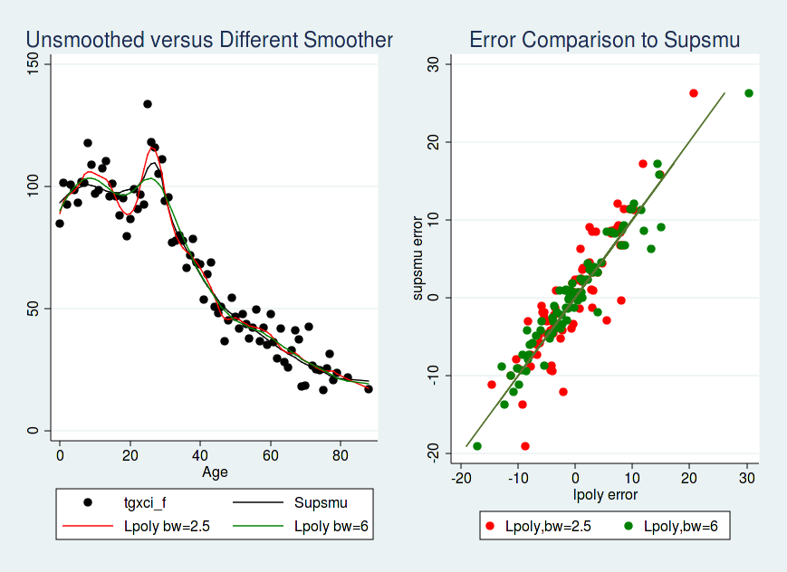
Comparing Smoothers
Example (welfare payments to families with young children):
Send me an email for more details

Slide 7
Review Results for Interesting Patterns
Examine results in time units and money units
  Time units are very interesting to people
  Difference in male/female patterns in time versus money units will also give interesting results
Can examine interesting patterns to investigate their causes
  Are patterns consistent across regions? Across socioeconomic status?
  Are they related to government programs, or cultural norms?
  If you have more than one time use survey, are patterns stable over repeated cross-sections?

Slide 8
Sensitivity Tests
Change methodology to evaluate how different results would be if you made different assumptions
Where is the methodology driving the results?
  Wage Imputation
    Opportunity cost versus replacement (BIGGEST EFFECT BUT ALSO NOT A REASONABLE ALTERNATIVE FOR ALL ACTIVITES; MAYBE IMPLEMENT JUST FOR CARE ACTIVITIES)
    Different wages used for replacement method
  Inclusion of activities
    Including secondary activities or not (ALSO BIG EFFECT)
    Including activities which may not pass the third party criterion

